Slide 1



CPSC 4338 2018 SP Team 4
David Halek
Eric Gomez
Jelane Carroll
“Dave” - 1178829
“Eric” - 1183748
“Lonnie” - 1176428

Slide 2
Project Overview
The purpose of this project is to create a way for company employees (users) to be able to access information about clients in real-time - accurately, and efficiently.
They will do this through the use of queries – which allow a user to specify criteria to the application, which will return a list of all the companies (by ID) which match.

Slide 3
Functional Requirements
Number | Requirement | Description
1000 | Nightly Processing | Enables the query module to work efficiently.
2000 | Query Module | Following are the query requirements:
2100 | Syntax | The syntax users will use – slide 6 will have more information on this.
2200 | Output | Output will be a list of company IDs that match user criteria.
2300 | Runtime | Must be executable in real-time, efficiently, and accurately.
2400 | Searchable Fields | Currently there are 22 searchable fields. These are listed in Appendix A.
2500 | User Interface | Users will have a command-line interface in a console window.
2600 | Parentheses | Parentheses will allow the user to specify the order of operations.
2625 | Intersection/Union | Users can use '&' for intersections and '+' and '|' to call for unions.
2650 | Set Subtraction | With '-' users can indicate for a set to be subtracted from another.
2675 | Not | User can call for the complement of a set with the '!' operator.
2700 | Expressions | = for exact match, < and > for ranges (using regular expressions).

Slide 4

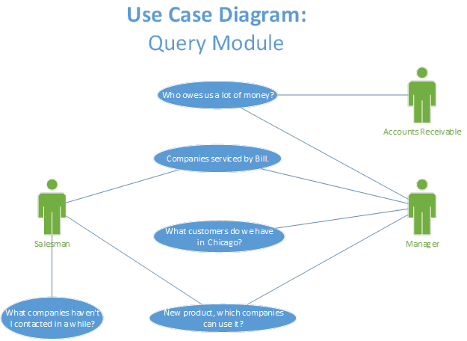
Project Design Summary
There are two major parts of this project:
The Nightly Processing Module creates a number of sequential files organized into directories matching the fieldnames for the queries. This allows queries to be executed almost instantly.
The Query Module is responsible for the user interface, processing of queries, and outputting results to the user.

Slide 5
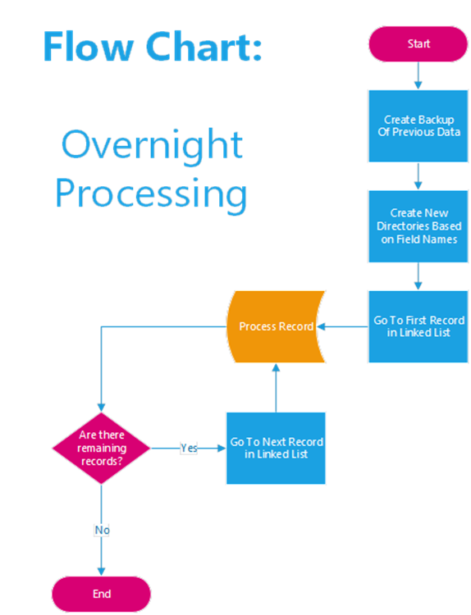
Overnight Processing
Data currently organized in a doubly-linked list
Process runs once a night
Creates directories for each field
Creates files for each value
All the IDs for companies located in Chicago would be in the following file:
~/city/Chicago
Separate from, but enables the Query Module

Slide 6
Query Module
Controls how queries are entered, parsed and processed.
Outputs a tab-separated list of company IDs that match user input.
Users enter a query into a console window on a command-line.
Users can look for a match using ‘=‘, ‘<‘, and ‘>’
Expressions can be exact match or use wildcards (regular expressions)
Operators:
() Specify order of operations
! Set Complement
& Intersection of two sets
|, + Union of two sets
- Subtract one set from another
Examples of possible queries (left is symbolic notation)
All companies that owe more than 2500
A AmountOwed>2500
All the companies Larry handles except for the ones in Detroit
A&!B Salesman=”Larry”&!city=”Detroit”
A-B Salesman=”Larry”–city=”Detroit”
All companies in Chicago other than those in zip codes 60629 and 60634
A&(B+C) City=”Chicago”&(zipcode=60629+zipcode=60634)
A-(B|C) City=”Chicago”–(zipcode=60629|zipcode=60634)
All companies in Chicago and all companies in Detroit
A+B City=”Chicago”+city=”Detroit”
A|B City=”Chicago”|city=”Detroit”

Slide 7
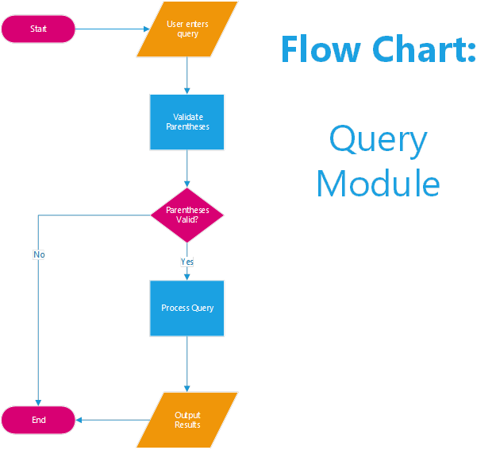
Query Module Design
Validate parentheses
Evaluate in proper order of operations:
Parentheses – from innermost first
Complement (!)
& (intersection), ! And + (union)
Set subtraction
In the case of equal precedence operations are performed from left to right
Output results

Slide 8
Validate Parentheses
Pseudocode
Equal numbers of left and right parentheses.
Parentheses match up properly.
Three counters are used – one to make sure balance is met, the other two are to output the counts to the user in the event of an error.
Counter incremented when a left parenthesis is encountered, it’s decremented on a right.
Trace of !(A+B)&(C-D)
Symbol | Actions taken | Counter | Left | Right
( | counter++, left++ | 1 | 1 | 0
) | counter--,right++ | 0 | 1 | 1
( | counter++, left++ | 1 | 2 | 1
) | counter--,right++ | 0 | 2 | 2

Slide 9
Process Query
Process query using correct order of operations:
This algorithm creates an expression in postfix notation:
!(A+B)&(C-D) ===> Ab+!cd-&
The table to the right shows the contents of the operator stack and the process queue as the input is processed.
Pseudocode
!(A+B)&(C-D)
Input (Queue) | Operator (Stack) | Process (Queue)
! | !
( | (!
A | (! | A
+ | +(! | A
B | +(! | AB
) | ! | AB+
& | & | AB+!
( | (& | AB+!
C | (& | AB+!C
- | -(& | AB+!C
D | -(& | AB+!CD
) | & | AB+!CD-
END |  | AB+!CD-&

Slide 10
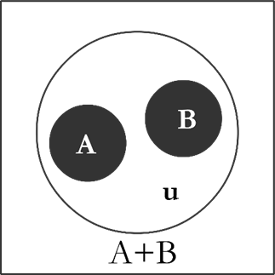
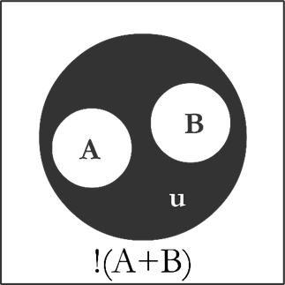
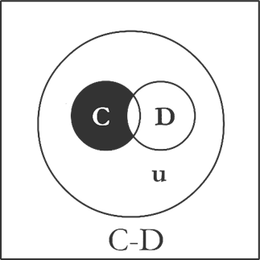
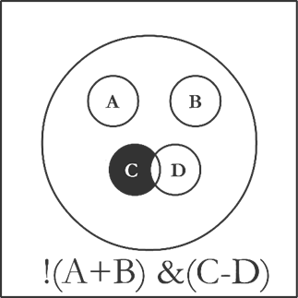
Process Postfix and Evaluate
Process Postfix
Evaluate Expression
Results

